Slide 1
2. Host Intrusion Detection
Intrusion Detection Module
Stephen Huang
Department of Computer Science
University of Houston
Notes:
Version 1, July 1, 2014
Proceedings of IEEE Symposium on Security and Privacy, 1996

Slide 2
Layout
Introduction
Related work
Defining Self
Experiments
Discussion and Conclusions

Slide 3
Introduction
Use the mechanism that natural immune system (NIS) uses:
Distributed detection, each copy of detection system is unique
Detection is probabilistic and on-line
Detectors are designed to recognize any foreign particle, not just those that have been previously seen.

Slide 4
Introduction
How to define self?
Need to be more dynamic than in the case of natural immune system,
Need the definition to be sensitive to dangerous foreign activities,
Problems about definition:
Too narrow will result in many false positives.
Too broad will result in many false negatives.

Slide 5
How to detect foreign object?
Build a database of foreign objects, anything not in this database is a “self” object.
New foreign object -> false negative
Build a database of “self” objects, anything not in this database is a foreign object.
New self object -> false positive

Slide 6
Introduction
This paper aimed at give a definition of self for Unix process: program normal behavior.
Here we define running program (process) normal behavior as sequence of system calls.
It is stable , significant, and simpler.

Slide 7
Introduction
Stable
The signature has low variance over a wide range of normal operating conditions and is specific to each different kind of process.
Significant
Because most prior work on intrusion detection has relied on either a much more complex definition of normal behavior or on prior knowledge about the specific form of intrusions.
Simple
Implement monitoring system in real time.

Slide 8
Intrusion Detection
Basic Approaches
Misuse Intrusion Detection:
The patterns of intrusion is known,
Identify intrusion by using the “signatures.”
Anomaly Intrusion Detection:
The nature of the intrusion is unknown,
The behavior is different from normal user.

Slide 9
Anomaly Intrusion Detection
Determine “profiles” for user behavior,
Intrusion detected when a user behaves out of character,
The anomalies are detected by using statistical profiles, neural networks, etc.
For each user, an audit trail of actions may have to be saved.

Slide 10
Alternative Approach
Only consider program running as root,
Use a program specification language to define process normal behavior,
System calls and parameters are formally specified.

Slide 11
New Approach
Similarity:
Consider processes that run as root,
Difference:
Simpler representation of normal behavior,
Ignore parameter values,
Rely on normal runs rather than formal specification of a program’s expected behavior.

Slide 12
Defining Self
Only consider privileged process
Monitoring privileged processes outperform monitoring user profiles:
Privileged processes are more dangerous than user processes because they have access to more parts of the computer system.
Privileged process a limited range of behavior and are relatively stable over time.
Limitation: cannot solve masquerading problem (disguise as other user).

Slide 13
Defining Self
Every program generates a system call sequence.
The sets of all system call sequences will be huge.
Any given execution of a program will likely produce a sequence of calls that has not been observed.
The local (short range) ordering of system calls appears to be consistent.
So we define these short sequence of system calls as the normal behavior of a program.

Slide 14
Normal Behavior
We use short sequences of system calls to define program behavior.
Establish a database of normal behavior for each interested process.
The process’s ongoing behavior is monitored.
Any deviation from normal behavior will indicate anomalies in the running process.

Slide 15
Normal Behavior
The definition ignores:
Parameters to the system calls,
Timing information,
Instruction sequences between system calls,

Slide 16
Example
open read mmap mmap open getrlimit mmap close
K = 3
Window size = k+1,

Slide 17
Short sequence
call | Position 1 | Position 2 | Position 3
open | read | mmap | mmap
read | mmap | mmap
mmap | mmap
Only used for the last subsequence

Slide 18
Database (whole sequence)

Slide 19
Testing
Original Sequence:
open read mmap mmap open getrlimit mmap close
Test sequence:
open read mmap open open getrlimit mmap close

Slide 20
open read mmap open open getrlimit mmap close

Slide 21
open read mmap open open getrlimit mmap close

Slide 22
open read mmap open open getrlimit mmap close

Slide 23
Defining Self
The maximum number of pairwise mismatches for a sequence of length L with a look-ahead of k is:
k(L-k)+(k-1)+(k-2)+…+1=k(L-(k+1)/2)
Where L : the length of total sequence
k: window size-1

Slide 24
Max. Number of pairs
• • • • • • • • • • • •
L-k
• • • • • • • • • • • •
k-1 k-2 .
.
1

Slide 25
Mismatches
Max. Mismatches (MM) = k(L-k)+(k-1)+(k-2)+…+1 = k(L-(k+1)/2)
For L=8, k=3, MM=18.
Actual number of mismatches = 4.
Miss rate: 4/18 = 22%

Slide 26
Experiments
Building a normal database
Distinguishing Between Processes
Anomalous Behavior

Slide 27
Building a normal database
We use sendmail to do experiment on Sun Sparc Station using SunOS 4.1.1
We use strace to gather information on system calls.
When building a normal database, the problem is how much and what kind of normal behavior is appropriate.

Slide 28
Generating Normal behavior
Generate an artificial set of test messages that exercises all normal modes of sendmail.
Monitor real users in hope to capture all normal behavior.

Slide 29
Building a normal database
If we fail to capture all the sources of legal variations, then the false positive will increase.
We use a suite of 112 artificially constructed messages, which include as many normal variations as possible.
Produce a combined trace length of over 1.5 million system calls, and
For window size 6, these messages produce a database with ~1500 entries.

Slide 30
Variability
All Possible
Normal

Slide 31
Normal or Abnormal
Count the number of mismatches,
Percentage of mismatches of total number of matches performed (length of the trace).
A threshold value is used
Below => Normal
Above => Abnormal

Slide 32
Building a normal database
Why the size of the normal database is of interest and important.
If the database is small, it is easier to check the signature in real time. If it is large, it will be expensive for on-line monitoring.
The size of the normal database gives an estimate of how much variability there is in the normal behavior of sendmail.

Slide 33
Building a normal database
How much normal behavior should be sampled to provide good coverage of the set of allowable sequences.
Enumerate potential sources of variation for normal sendmail operation.
Generate example mail messages that cause sendmail to exhibit these variations.
Build a normal data base from the sequences produced by step 2.
Continue generating normal mail messages, recording all mismatches and adding them to the normal database as they occur.

Slide 34
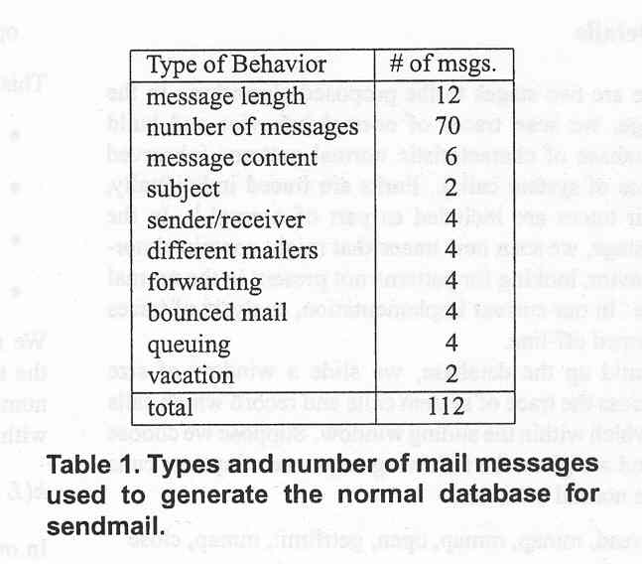
Building a normal database
Types and number of mail messages used to generate the normal database for sendmail.

Slide 35
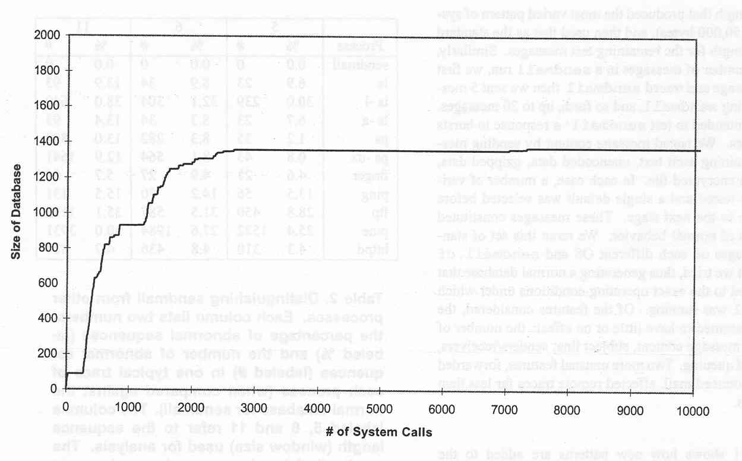
The figure shows how new patterns are added to the database over time during a normal sendmail run.

Slide 36
Building a normal database
The variability in the behavior of sendmail at the system call level is much smaller than we expected.

Slide 37
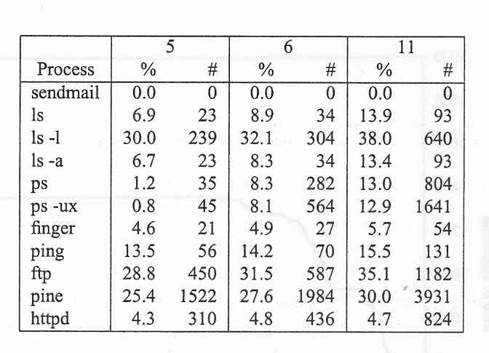
Distinguishing Processes
It is easy to distinguish the behavior of different processes using sequence of system call

Slide 38
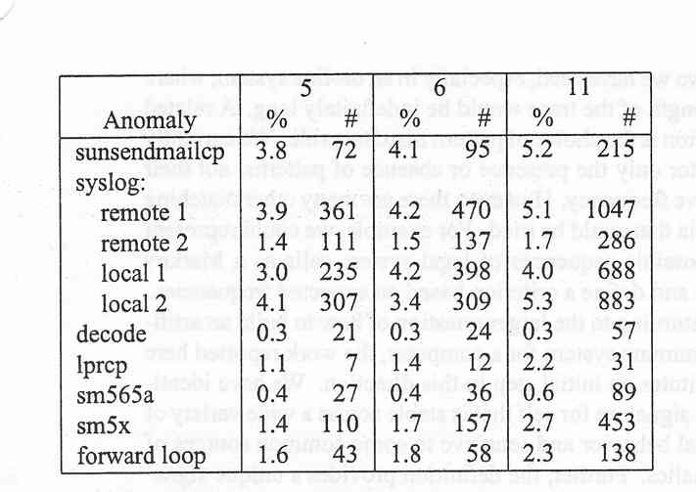
Anomalous Behavior

Slide 39
Anomalous Behavior
Three types of behaviors:
Successful sendmail intrusions
Failed sendmail intrusions
Error conditions
Compared with normal sendmail database.

Slide 40
Anomalous Behavior
Four attacks are traced: (successful)
Sunsendmailcp: uses a special command line option to cause sendmail to append an email message to a file.
Syslog attack uses the syslog interface to overflow a buffer in sendmail. This attack can be run either locally or remotely.
Lprcp attack script uses lpr to replace the contents of an arbitrary file with those of another.
Decode attack, contact the paper.

Slide 41
Anomalous Behavior
Unsuccessful
Sm565a
sm5x

Slide 42
Error conditions
Local forward loop occurs when a set of $HOME/.forward files form a logical circle. Such as:
Email address .forward file
foo@host1 bar@host2
bar@host2 foo@host1
It is not malicious, but still affect machine’s performance.

Slide 43
Discussion and Conclusions
This approach is predicated on two important properties:
The sequence of system calls executed by a program is locally consistent during normal operation.
Some unusual short sequences of system calls will be executed when a security hole in a program is exploited.

Slide 44
Discussion and Conclusions
If an intrusion does not fit into either of these two categories.
In the case of intruder stealing a resource (such as a file) created by a program running as root. (Racing)
In the case of intruder using another user’s account.

Slide 45
Discussion
We use short sequences only. No frequency information is used.
More flexibility in matching trace with the database.
Storing signatures of known intruders.
Currently “self” does not change over time.

